Slide 1

Kickstarter Fundraising
Team members: BeiSu, Fangzhou zheng, Haojiang Wu

Slide 2
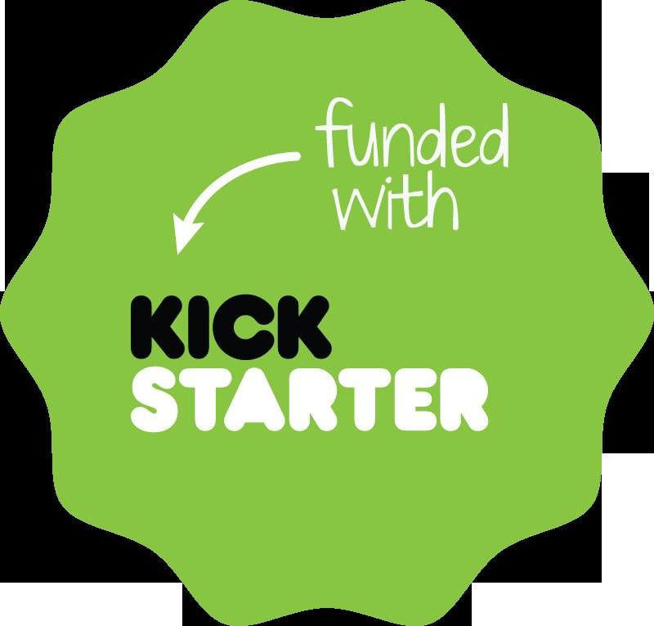
Problem Statement
Platform Overview: Kickstarter enables creators to fund projects by setting financial goals within a specific timeframe.
Challenge: Success rates differ widely across campaigns.
Key Factors: Funding goals, project categories, and timing significantly influence outcomes.
Impact: Creators lack clarity on factors driving success, making it difficult to design effective campaigns.
Result: Many impactful projects fail to secure funding and remain unrealized.

Slide 3
Who Cares About This Problem and Why?
Project Creators
Better Campaign Design:
Use insights to set goals, timings, and durations strategically.
➡️ Higher success rates and efficient resources.
Refined Marketing:
Focus on resonant project categories and audience targeting.
Why
More Engagement:
Higher success rates attract creators and enhance reputation.
Smarter Recommendations:
Data-driven advice boosts creator and user satisfaction.
Who
Better Campaigns:
Access to curated, realistic, and engaging projects.
Increased Trust:
Higher success fosters confidence in the platform.

Slide 4
Data ：
Kickstarter Campaigns: https://webrobots.io/kickstarter-datasets/
Data set includes projects from 2010 to February 2019.
To improve the accuracy of the prediction model, we only collected projects from 2018 to 2019 Feb.
Categorical & Numeric
In order to make the model more accurate, we selected "status" and country in the data as our categorical, and the rest of the start time, start quarter, amount, duration, etc. as our numeric
Through this formula：sns.pairplot(sampled_data[numeric]).
We found that goal_usd and duration are positively correlated and highly correlated. We believe that we can study it from these two aspects.the
74.489K
1.074 K
Unique ID
Category

Slide 5
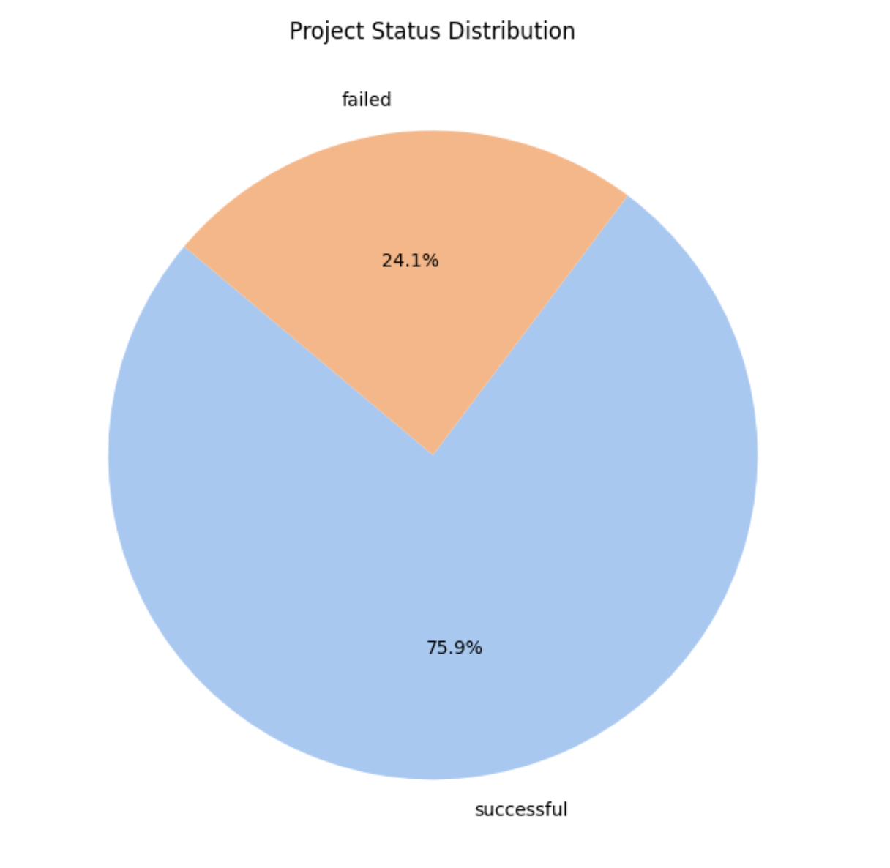
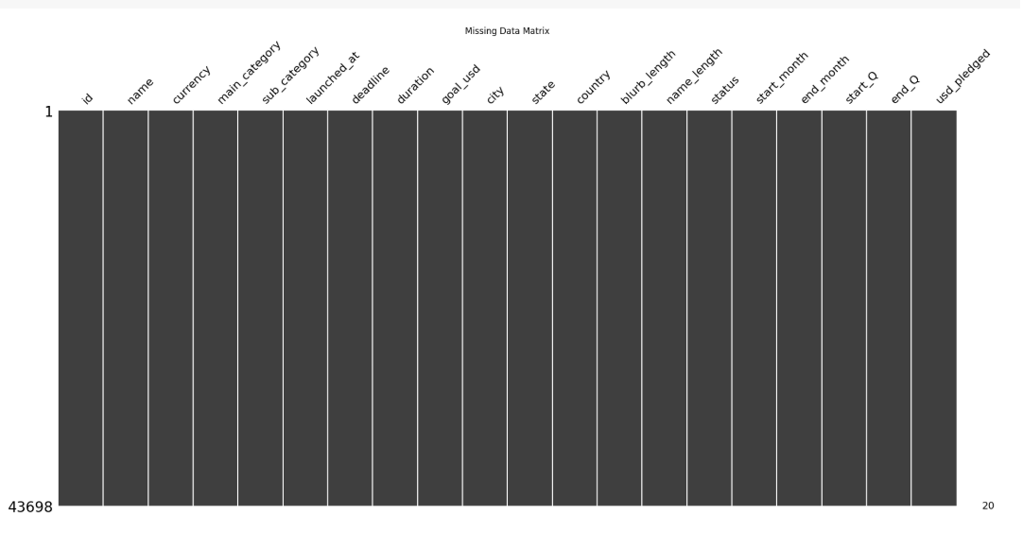
KEY FINDINGS of EDA
Our data is sufficiently clean, with no missing values.
Project Status Distribution shows that the Success Rate dominates at nearly 76%.

Slide 6
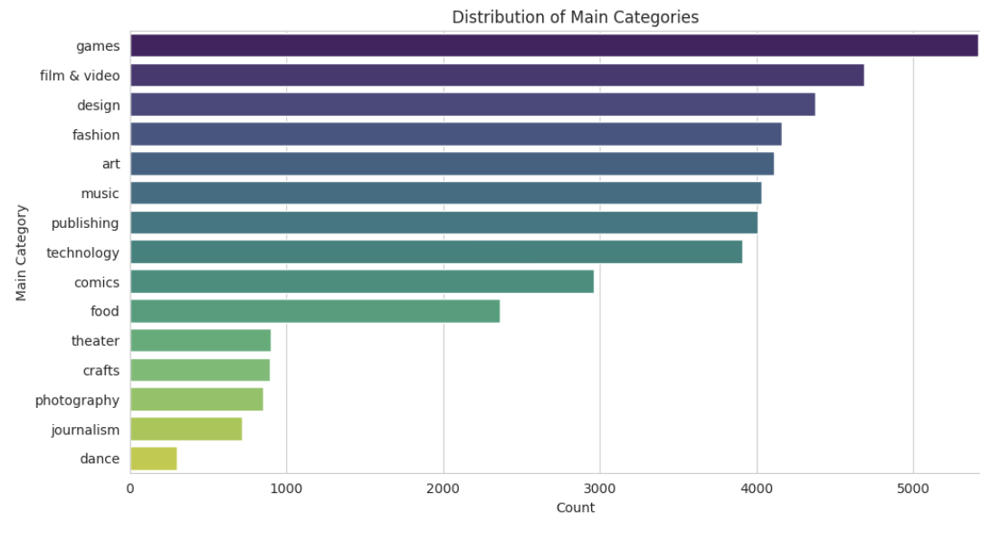
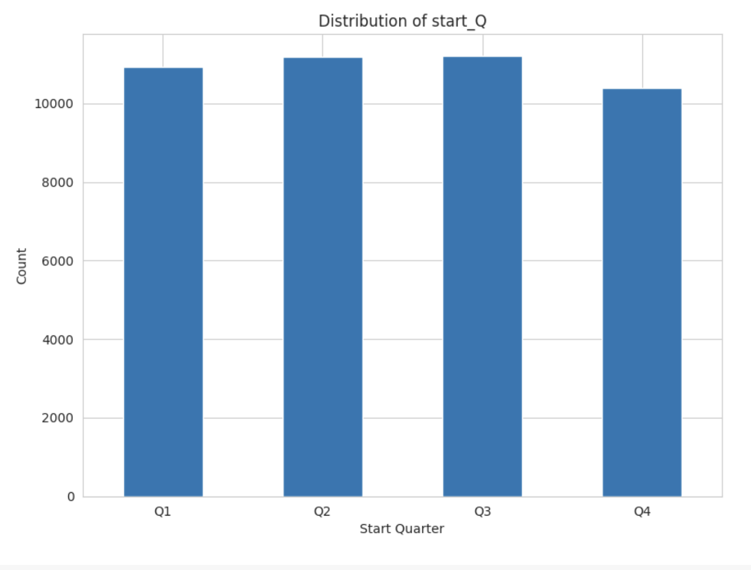
Distribution of Main Categories: Games dominate as the top categories, reflecting their popularity and potential market demand.
Quarterly project launch： Observing the data from 2018, we found that the number of projects launched in each quarter is not very different, and there is a slight lead in the number of projects launched in Q2 and Q3.

Slide 7
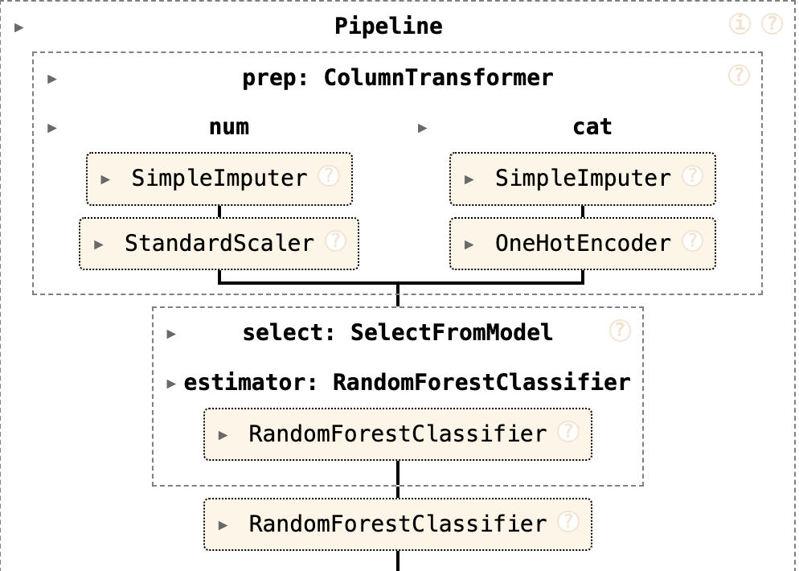
Feature Selection
We used the random forest classifier to filter out important features and then used these features to train our model.

Slide 8
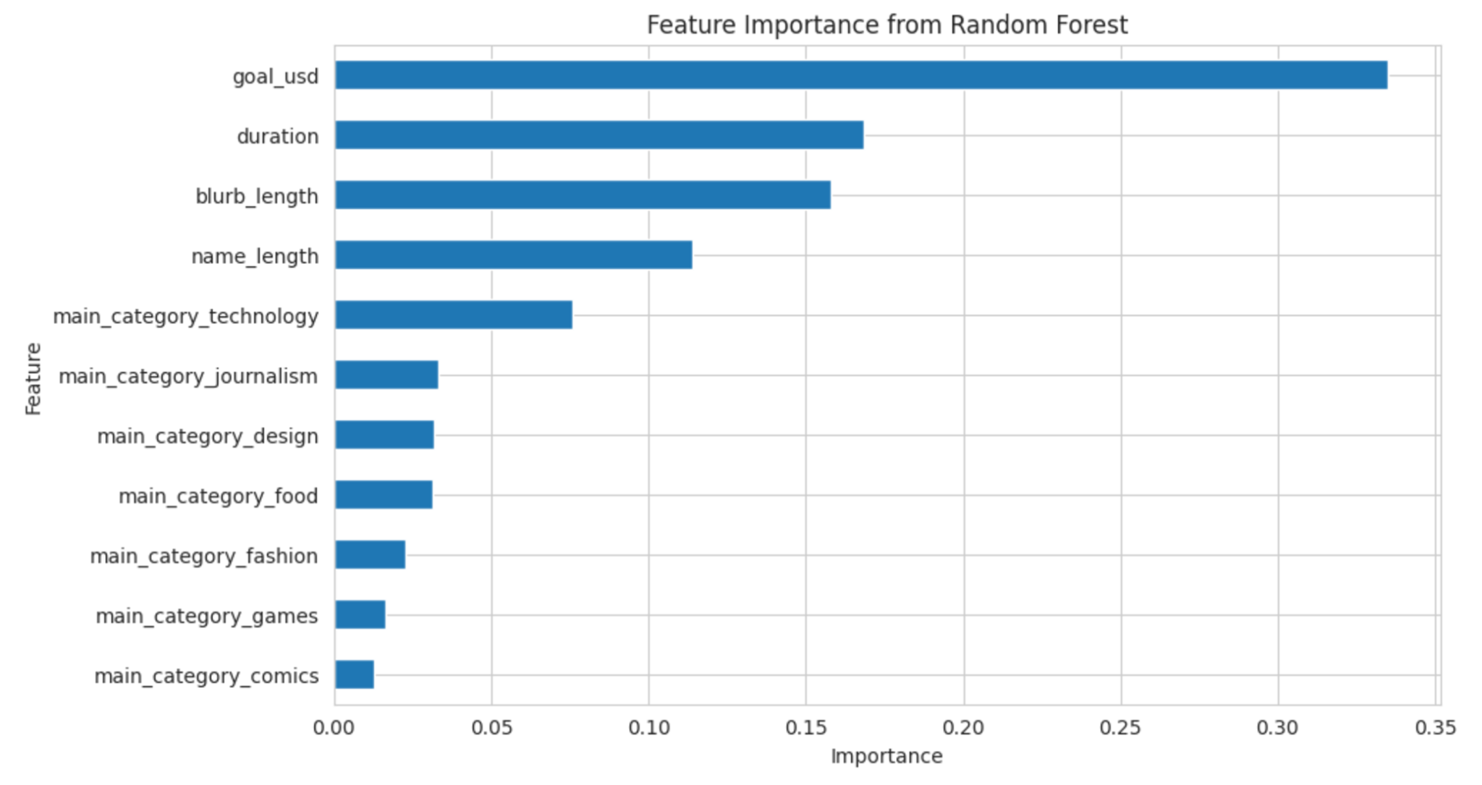

Slide 9
Evaluate Model
Model Training and Evaluation
Random Forest
Logistic Regression
K-Nearest Neighbors

Slide 10
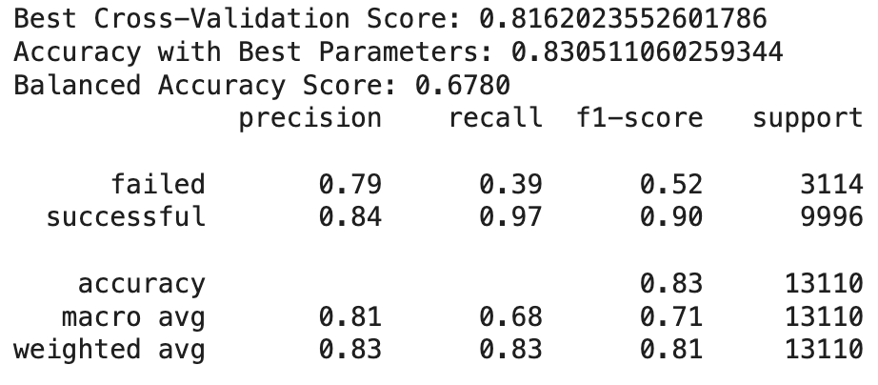
Random Forest
Final Results:
Balanced Accuracy: 0.678
Test Accuracy: 0.830
Class Performance:
  Successful Projects: Precision 0.84, Recall 0.97
  Failed Projects: Precision 0.79, Recall 0.39
Conclusion:
The model performs well overall, especially in predicting successful projects.
Strong performance for the “successful” class , but struggled with the “failed” class.

Slide 11
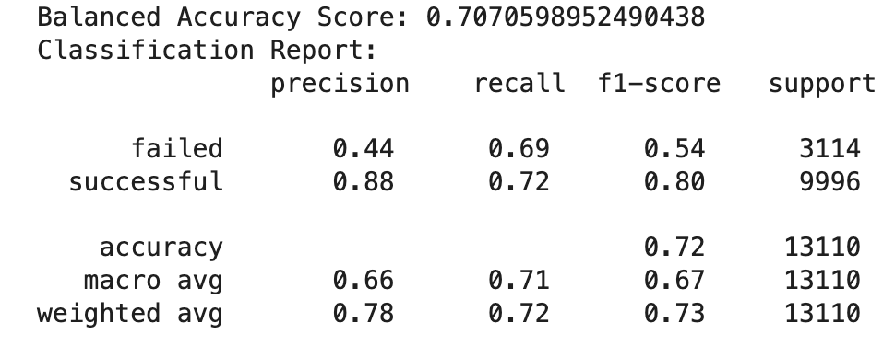
Logistic Regression
Methods Used to Improve Accuracy:
Grid Search Tuning
Random Search
Bayesian Optimization
Key Findings:
Bayesian Optimization achieved the highest balanced accuracy: 70.7%
Moderate performance in identifying failed projects.

Slide 12
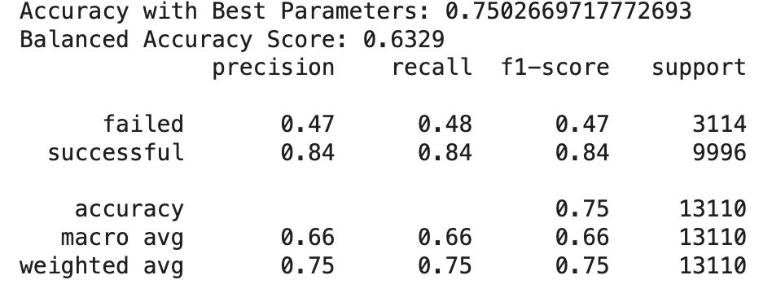
K-Nearest Neighbors
Hyperparameter Tuning:
Methods used: GridSearchCV and RandomizedSearchCV
Model Performance:
Accuracy: 75.03%
Balanced Accuracy: 63.29%
Key Improvements:
The model achieved an accuracy of 0.75 and a balanced accuracy score of 0.633, moderate performance in handling class imbalance.
The model performed well for the “successful” class with a precision and recall of 0.84, while struggling with the “failed” class, achieving lower precision (0.47) and recall (0.48)

Slide 13
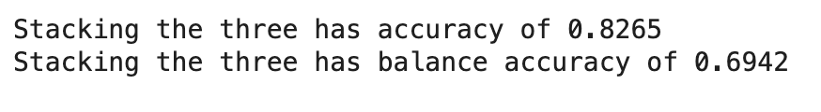
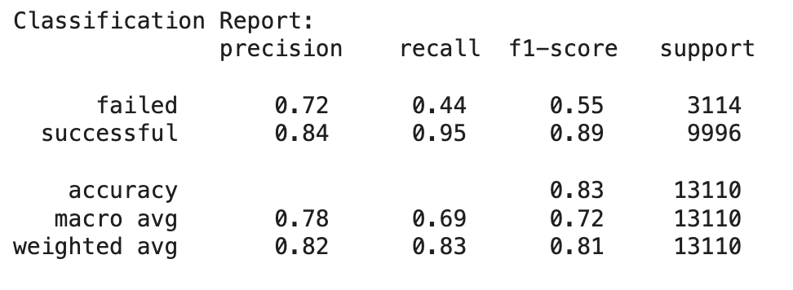
Which methods worked best for your problem?
Model Framework:（Stacking Classifie）
Basic Learners: Random Forest, Logistic Regression, K-Nearest Neighbor (KNN).
Final Classifier: Stacking method.
Test Accuracy: 82.65%
Balanced Accuracy: 69.42%
Successful Class:
F1 Score: 0.89
Strong performance in identifying successful campaigns.
Failed Class:
F1 Score: 0.55
Indicates room for improvement in distinguishing failed campaigns.
Notes:
This is because the proportion of successful cases in our original data is as high as 75%.

Slide 14
What Challenge We Faced?
Increase in computational effort:
Computational resources take a long time, especially on large sets.
Category Imbalance
The proportion of "successful" and "failed" projects in the dataset is extremely imbalanced
Parameter search takes too much time
The search space is too large, resulting in a long search time
Notes:
There are three main challenges in our analysis

Slide 15
Conclude
Data Preparation:
  Comprehensive data cleaning and transformation.
  Exploratory Data Analysis (EDA) to identify trends and outliers.
Feature Selection:
  Key predictive features identified using Random Forest classifiers.
  Ensured model focus on impactful attributes.
Techniques Used:
  Hyperparameter tuning with GridSearchCV.
  Models built: Random Forest, Logistic Regression, K-Nearest Neighbors (KNN).
Best Performer:
  Stacking Classifier:
    Combined Random Forest, Logistic Regression, and KNN as base models with XGBoost as the meta-classifier.
    Balanced Accuracy: 0.6942.
    Outperformed standalone models by leveraging their combined strengths.
Our analysis provided actionable insights into the factors driving campaign success, which offering valuable guidance for Kickstarter creators aiming to optimize their fundraising strategies. The results emphasize the importance of balancing class predictions and selecting appropriate evaluation metrics, providing a foundation for further improvements in predictive modeling

Slide 16
Next Steps
Advanced Models: Explore LightGBM or CatBoost for better handling of class imbalance and categorical features.
Hyperparameter Optimization: Utilize efficient methods to refine parameters and reduce computation time.
Class Imbalance: Apply techniques like SMOTE or adaptive class weighting to enhance predictions for the "failed" class.
Temporal Analysis: Analyze feature trends over time to adapt to crowdfunding dynamics.

Slide 17
  Thank You!

